Slide 1

H4rdWeared
Smart India Hackathon 2020

Slide 2
Soldier Strap
This project intends to focus on the following:
GPS location of the soldier
Monitors and records maximum number of vital body parameters
SoS Facility
Sufficient Battery Life
Should support location timeline
Communication via MANET communication

Slide 3
OUR VISION
It is our belief that the defense force’s safety and security is of great importance, and thus we have come up with several ideas that can be implemented in a compact and economically-feasible manner.
The following slides will give you insight into our ideas and its implementation.

Slide 4
Ideas
1. Establishing the google geolocation API with nodeMCU
2. MANET communication with intention of sending a multiple characters for intra-fleet communication .
3. CO2 sensor to detect the co2 levels in the environment to signal the soldier about increasing co2 levels .
4. Data logging the mi band 3 to take the heart rate data.
5. EEG sensor to check the emotional stability of the soldier

Slide 5
APPROACH
Establishing the google geolocation API with nodeMCU:
Our main intention of this project is to help with inter and intra battalion communication. We are using two NodeMUCs as the groundwork for a large network of communication. Amongst these two, one works as a server and the other works as a client.
Using the Google geolocation API, soldiers within the battalion will be able to track each others location.

Slide 6
APPROACH
MANET communication with intention of sending a multiple characters for intra-fleet communication:
We will be using this for SoS facility so that if a soldier strays away from the battalion, he can get the help he needs.
This is an extension of our previous slide, using server-client communication.
Many military systems are now using MANET as a preferred method of communication, due to its flexibility and security.

Slide 7
APPROACH
Data logging the MI band 3 to take the heart rate data:
We are using heart rate as a vital parameter to be considered. We are implementing this via a MI band 3. We are taking live data from this band and interpreting this, i.e, if the heart rate cross a certain level, it signals fellow soldiers. This can help in understand the anxiety and stress that a soldier is going through.
According to a study done by several renowned Cardio-related journals, increased heart rate is linked to anxiety and PTSD, which is common in the military field.

Slide 8
APPROACH
EEG sensor to check the emotional stability of the soldier:
Plotting a graph to understand the emotional and mental stability of the soldier.

Slide 9

APPROACH
CO2 sensor to detect the co2 levels in the environment to signal the soldier about increasing co2 levels:
According to a recent study done at University of Texas, Austin, inhalation of excess CO2 can affect the emotional and mental stability of a soldier

Slide 10
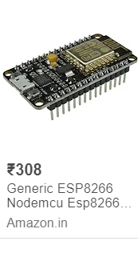
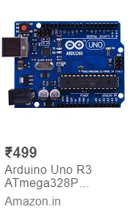
IS IT COST EFFECTIVE ?

Slide 11
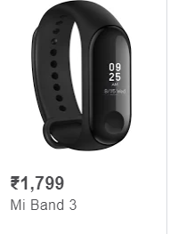

Slide 12
IS IT COST EFFECTIVE
We are using:
2 X NodeMCU= 600-650
1 X Arduino = 500
1 X MI Band 3= 1800
Buffer price( wires and other equipment) = 500
Total Price= 2500

